Slide 1
Multilevel Queue
ESHAN COLLEGE OF ENGINEERING, MATHURA

Slide 2
ESHAN COLLEGE OF ENGINEERING, MATHURA
Ready queue is partitioned into separate queues:
foreground (interactive)
background (batch)
Each queue has its own scheduling algorithm:
foreground – RR
background – FCFS
Scheduling must be done between the queues:
Fixed priority scheduling; (i.e., serve all from foreground then from background). Possibility of starvation.
Time slice – each queue gets a certain amount of CPU time which it can schedule amongst its processes; i.e., 80% to foreground in RR 20% to background in FCFS

Slide 3
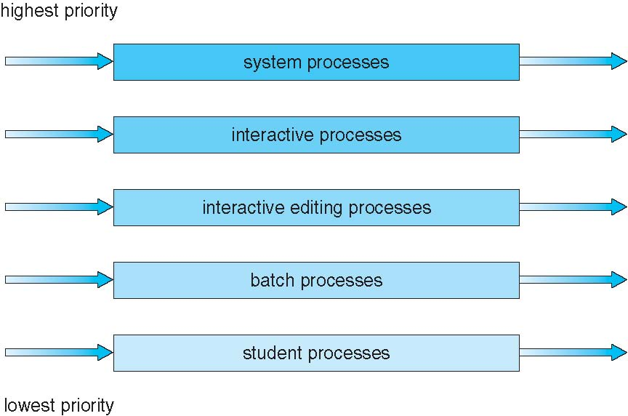
ESHAN COLLEGE OF ENGINEERING, MATHURA
Multilevel Queue Scheduling

Slide 4
ESHAN COLLEGE OF ENGINEERING, MATHURA
Multilevel Feedback Queue
A process can move between the various queues; aging can be implemented this way.
Multilevel-feedback-queue scheduler defined by the following parameters:
number of queues
scheduling algorithms for each queue
method used to determine when to upgrade a process
method used to determine when to demote a process
method used to determine which queue a process will enter when that process needs service

Slide 5
ESHAN COLLEGE OF ENGINEERING, MATHURA
Example of Multilevel Feedback Queue
Three queues:
Q₀ – RR with time quantum 8 milliseconds
Q₁ – RR time quantum 16 milliseconds
Q₂ – FCFS
Scheduling
A new job enters queue Q₀ which is served FCFS. When it gains CPU, job receives 8 milliseconds. If it does not finish in 8 milliseconds, job is moved to queue Q₁.
At Q₁ job is again served FCFS and receives 16 additional milliseconds. If it still does not complete, it is preempted and moved to queue Q₂.

Slide 6
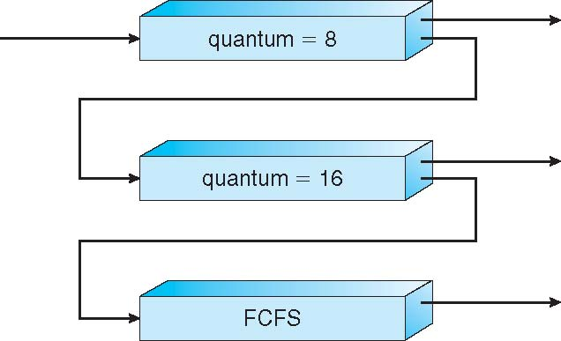
ESHAN COLLEGE OF ENGINEERING, MATHURA
Multilevel Feedback Queues

Slide 7
ESHAN COLLEGE OF ENGINEERING, MATHURA
Thread Scheduling
Distinction between user-level and kernel-level threads
Many-to-one and many-to-many models, thread library schedules user-level threads to run on LWP
Known as process-contention scope (PCS) since scheduling competition is within the process
Kernel thread scheduled onto available CPU is system-contention scope (SCS) – competition among all threads in system

Slide 8
ESHAN COLLEGE OF ENGINEERING, MATHURA
Pthread Scheduling
API allows specifying either PCS or SCS during thread creation
PTHREAD SCOPE PROCESS schedules threads using PCS scheduling
PTHREAD SCOPE SYSTEM schedules threads using SCS scheduling.

Slide 9
ESHAN COLLEGE OF ENGINEERING, MATHURA
Pthread Scheduling API
#include <pthread.h>
#include <stdio.h>
#define NUM THREADS 5
int main(int argc, char *argv[])
{
int i;
pthread t tid[NUM THREADS];
pthread attr t attr;
/* get the default attributes */
pthread attr init(&attr);
/* set the scheduling algorithm to PROCESS or SYSTEM */
pthread attr setscope(&attr, PTHREAD SCOPE SYSTEM);
/* set the scheduling policy - FIFO, RT, or OTHER */
pthread attr setschedpolicy(&attr, SCHED OTHER);
/* create the threads */
for (i = 0; i < NUM THREADS; i++)
pthread create(&tid[i],&attr,runner,NULL);

Slide 10
ESHAN COLLEGE OF ENGINEERING, MATHURA
Pthread Scheduling API
/* now join on each thread */
for (i = 0; i < NUM THREADS; i++)
pthread join(tid[i], NULL);
}
/* Each thread will begin control in this function */
void *runner(void *param)
{
printf("I am a thread\n");
pthread exit(0);
}

